Slide 1

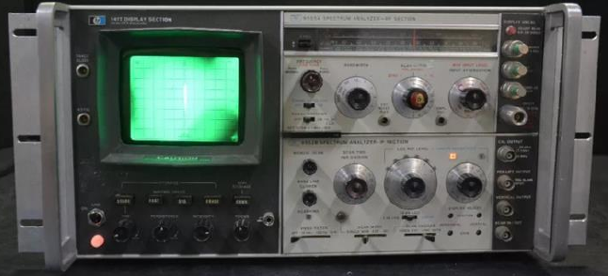
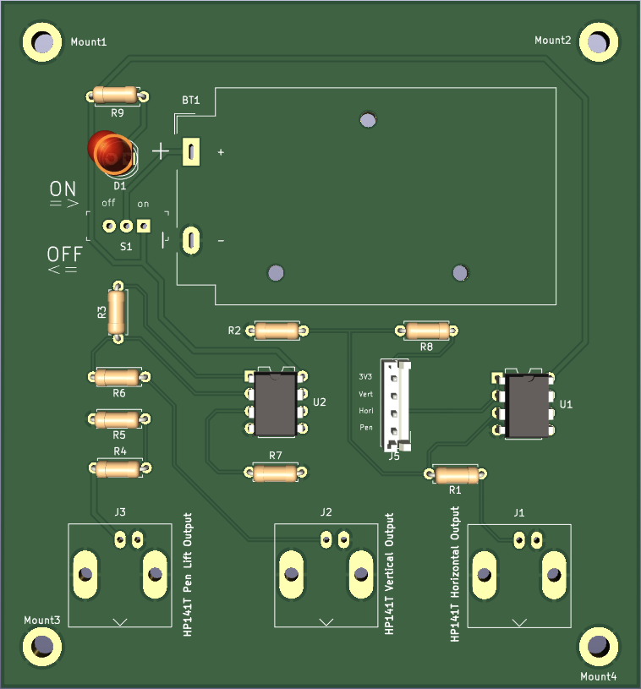
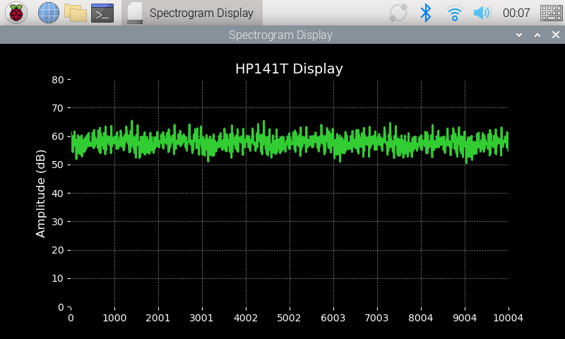
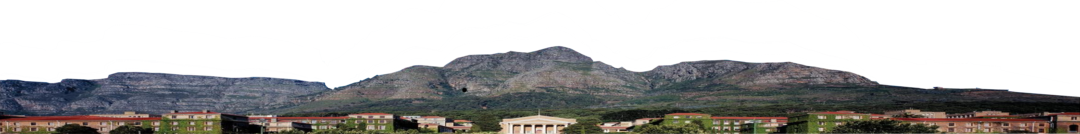
Digitizing and Modernizing an HP141-display
EEE4022F 2025
Bonga Njamela, University of Cape Town, South Africa
Supervised by Dr Stephen Paine & Professor Emeritus Michael Inggs,
Department of Electrical Engineering
28 May 2025

Slide 2
Introduction
28 May 2025
HP141T Spectrum Analyzer
A spectrum analyzer designed and patented in the 1970s
Focus on replacing the outdated CRT with a single board computer and LCD touchscreen.
Aims to retain wide frequency bandwidth (10 MHz to 18 GHz) and enhance signal processing capabilities.
Figure 1: The HP141T with the 8555A RF and 8552B IF sections.
Digitizing and Moderning a HP141-display
1

Slide 3
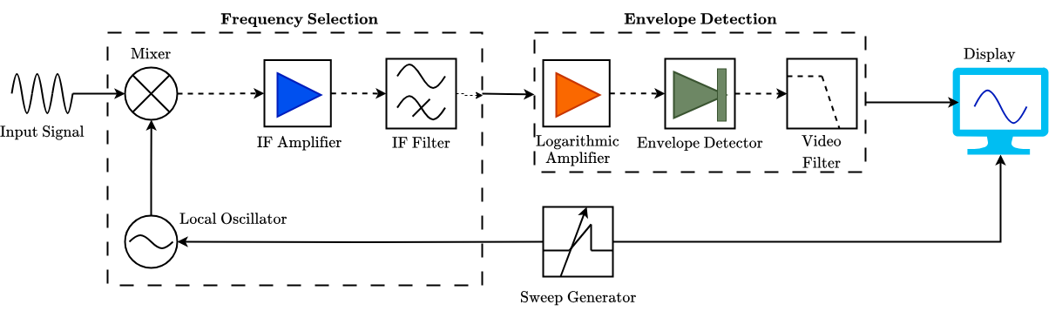
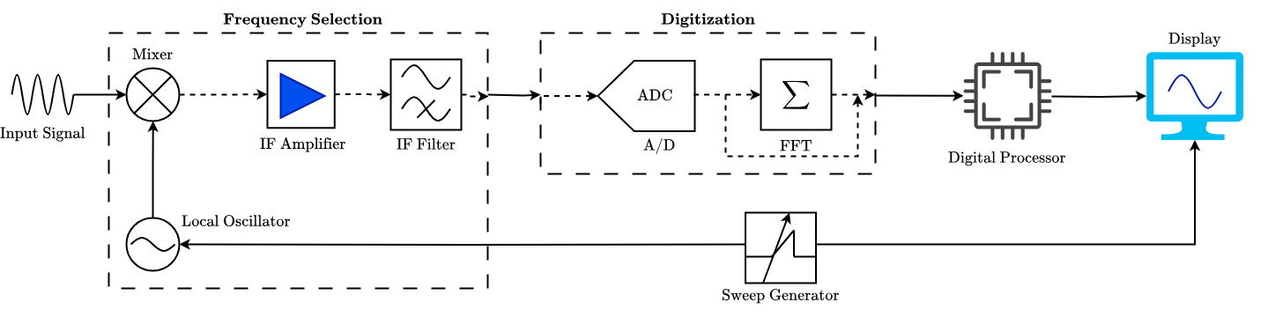
Background
28 May 2025
Mitigating the Obsolescence of the HP141T Based On Modern Spectrum Analyzers
Uses the superheterodyning principle to present a signal's spectrum (amplitude vs frequency)
Advantages
Absolute amplitude calibration, high resolution, and expandable tuning sections.
Limitations
CRT degradation, persistence effects (0.1 s to 15 s), and outdated technology.
Figure 2.1: Operation of HP141 is based on the superheterodyning principle.
Figure 2.2: Operation of Modern Real-Time Spectrum Analyzers (RTSA)s.
Digitizing and Moderning a HP141-display
2
[1] A. I. Harris, “Heterodyne Spectrometers with Very Wide Bandwidths,” in Millimeter and Submil-limeter Detectors for Astronomy, vol. 4855. SPIE, 2003, pp. 279–289.

Slide 4

Objectives
28 May 2025
Motivation
Interface with modern LCD to overcome CRT issues and introduce software features.
Aims of the Project
To design a digital display compatible with H141T voltage outputs for analog signal plotting.
To develop computer-aided features like signal normalization and data storage.
To conduct survey of HP8555A RF and HP8552B IF outputs, single board computer, and touchscreen options.
Deliverables: Characterization, hardware selection, interface design, signal processing algorithms, and system test results.
Digitizing and Moderning a HP141-display
3

Slide 5
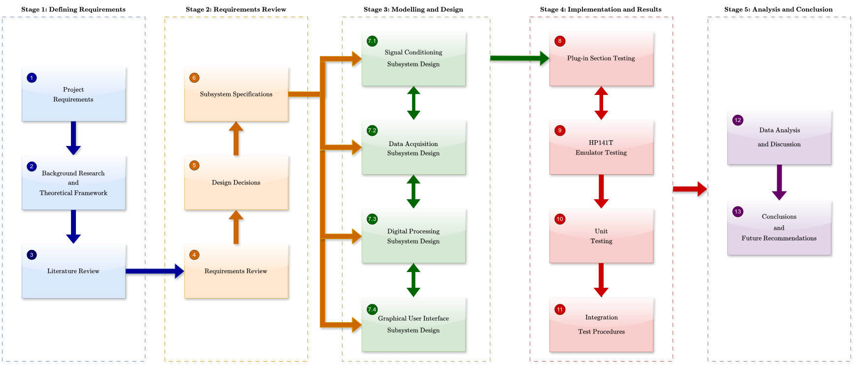
Methodology
28 May 2025
Phases of the Research and Design Process
Phase 3: Design and Simulations
Phase 4: Testing
Phase 1: Research
Phase 2: Requirements Review
Phase 5: Conclusions
Digitizing and Moderning a HP141-display
4

Slide 6
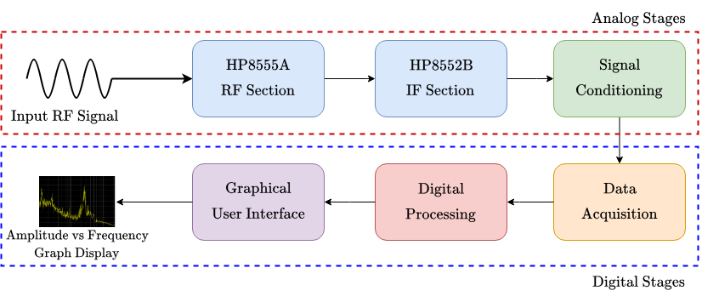
Methodology
28 May 2025
Digitized System Overview
System Scope: Modernize HP141T by replacing CRT with LCD touchscreen, retaining 8555A/8552B plug-ins.
Subsystems
Signal Conditioning (SCS): Scales auxiliary outputs (e.g., -0.8 V to 3.3 V) for ADC compatibility.
Data Acquisition (DAS): Digitizes signals using dual 16-bit ADCs at 7 MSPS on STM32H723ZG.
Digital Processing (DPS): Processes data on Raspberry Pi 4B for display modes (PHM, AVM, RWM).
Graphical User Interface (GUIS): Displays on 7-inch TFT touchscreen with 8x10 grid.
Features: Real-time spectrum display, trace storage, and user interaction via touch controls.
Figure 5: Overall system diagram.
Digitizing and Moderning a HP141-display
5

Slide 7
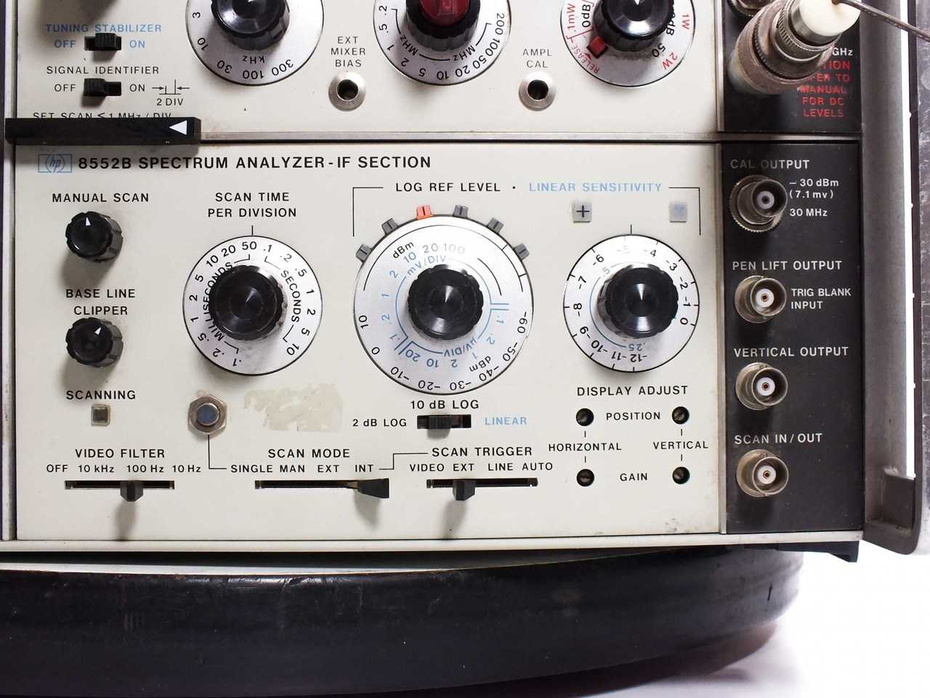
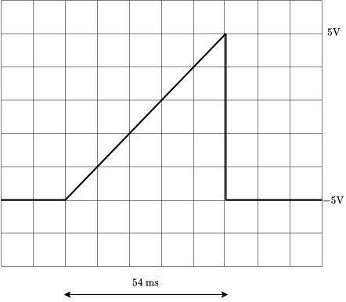
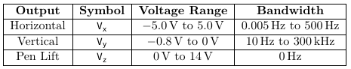
Methodology
28 May 2025
HP141T System Specifications from User Manuals
Power: 220 V single-phase, 60 Hz, < 225 W with plug-ins.
CRT Display:
9 kV accelerating potential, P31 phosphor, 8x10 division graticule.
Frequency bandwidth: up to 2 GHz per sweep, tunable to 18 GHz.
Resolution: 100 Hz/division to 2 kHz/division.
Outputs:
Pen-Lift: 0 V to 14 V.
Vertical Output: 0 V to -0.8 V.
Horizontal Output: -5 V to 5 V (sawtooth).
Implications: New display must match resolution and voltage ranges.
Vx
Figure 6.1: Highlighting of HP8552B IF Section Outputs
Figure 6.2: Sawtooth scan output for analyzing
Table 6.1: Characteristics of the HP141T Auxiliary Outputs
Digitizing and Moderning a HP141-display
6

Slide 8
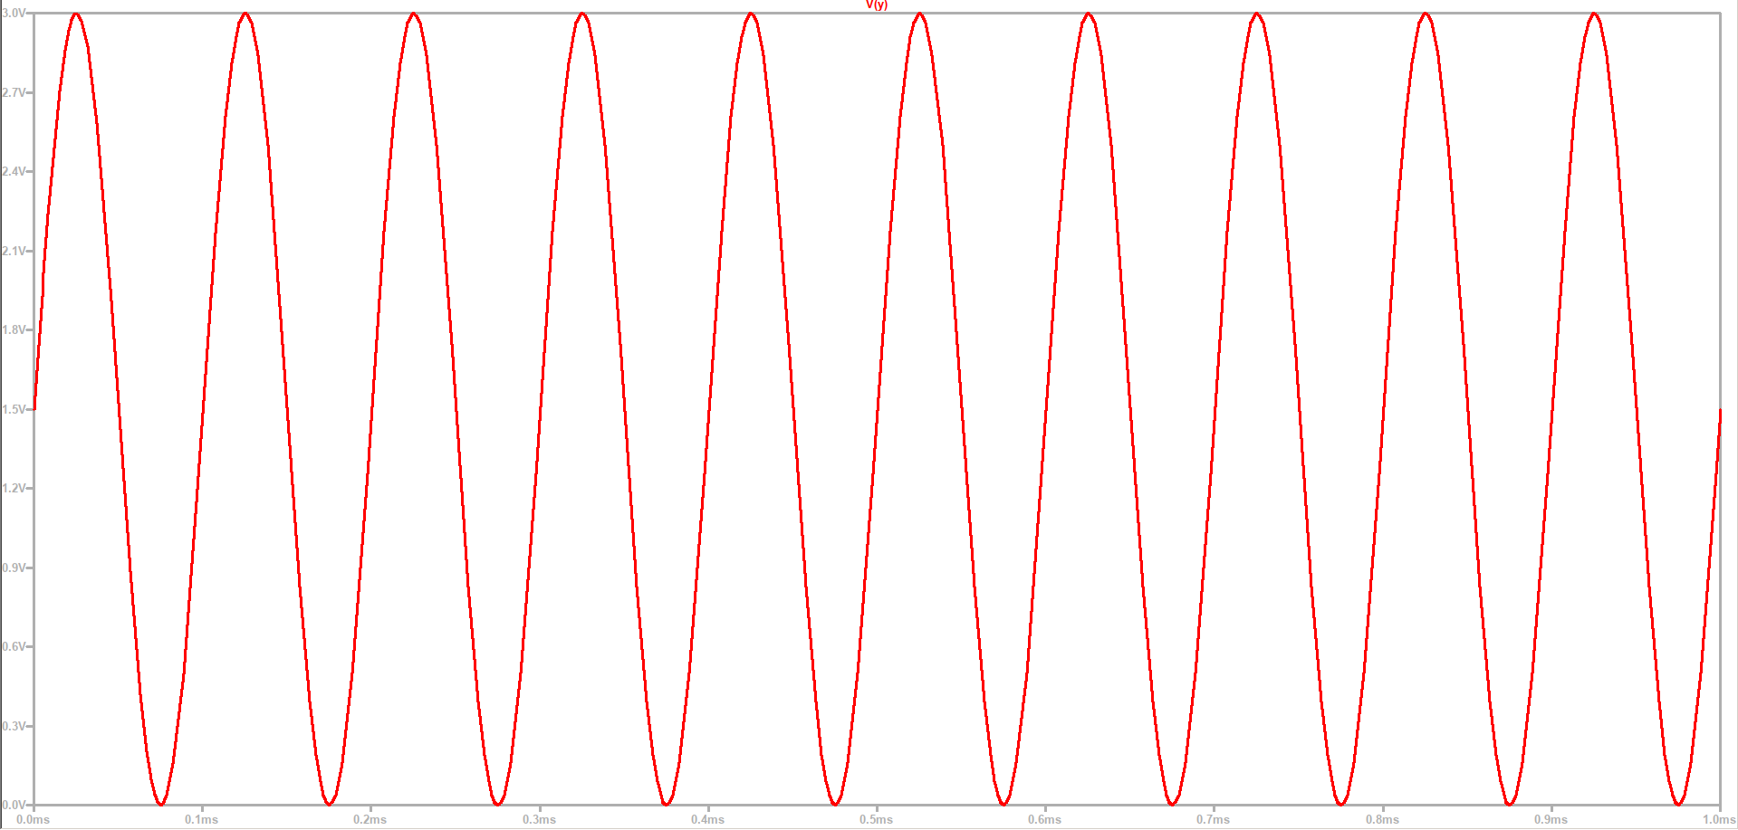
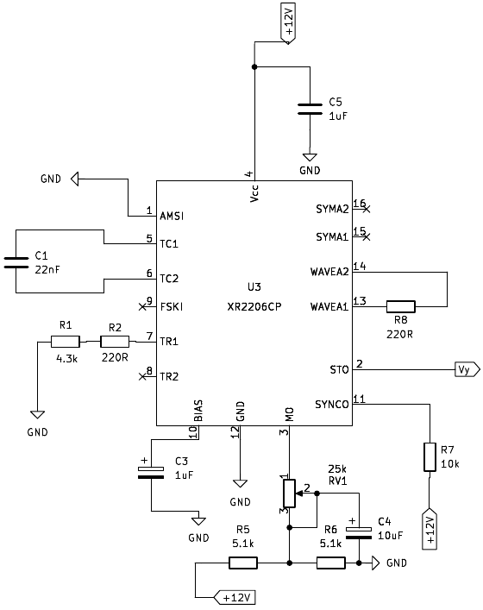
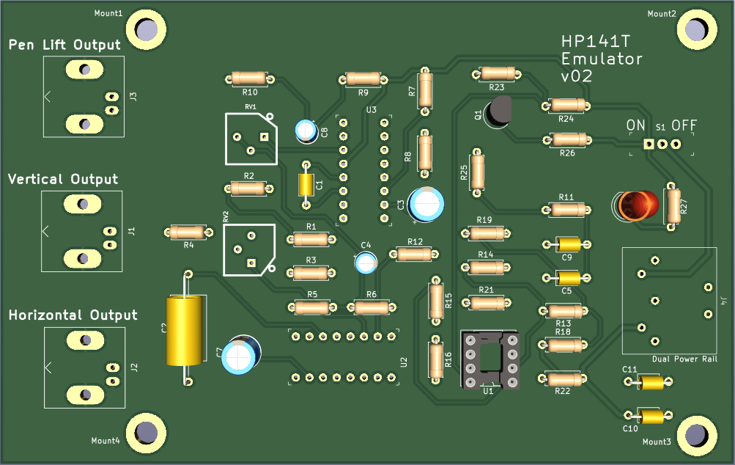
Methodology
28 May 2025
HP141T Emulator Subsystem Design
Purpose: Emulate CRT auxiliary outputs (vertical, horizontal, pen-lift) for digital conversion.
Design:
Use 555-timer for sawtooth signal (-5 V to 5 V, adjustable frequency).
Voltage biasing circuit with potentiometer for vertical (0 V to 3.0 V) and pen-lift (0 V to 14 V) outputs.
Interface with signal conditioning circuit using same cables as HP141T.
Testing: Verify with Picoscope 2204A against expected voltage ranges (UTB00-UTB04).
Figure 7.2: Simulated sinusoidal vertical output
Figure 7.1: XR2206-based 85552B waveform generator
Figure 7.3: HP141T Emulator Circuit Board
Digitizing and Moderning a HP141-display
7

Slide 9
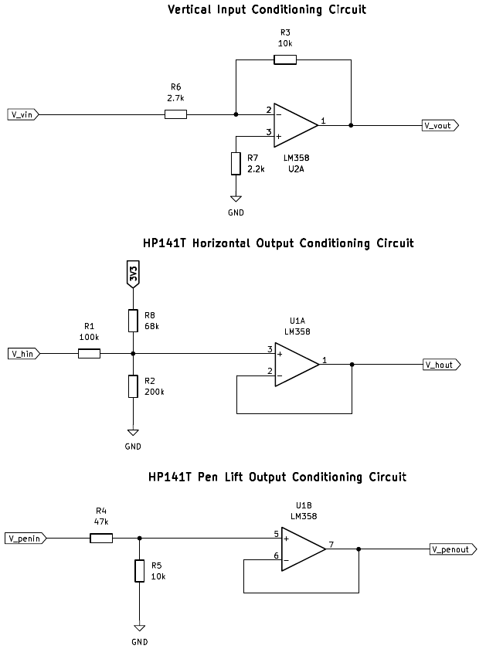
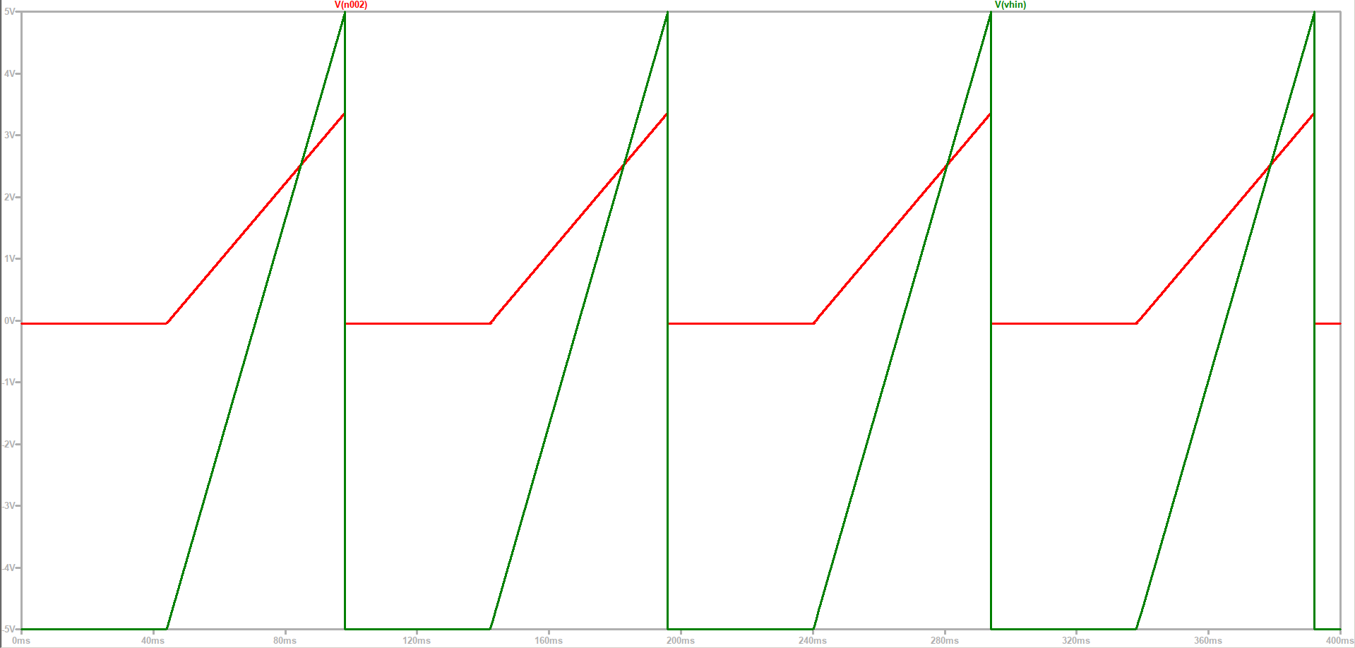
Methodology
28 May 2025
Signal Conditioning Subsystem (SCS) Design
Goal: Condition HP141T analog outputs for ADC compatibility.
Design:
Use op-amp circuits with gain A to scale outputs (e.g., -0.8 V to 0 V → 0 V to 3.3 V).
Logic level-shifters to shift voltages (e.g., -5 V to 5 V → 0 V to 3.3 V).
Include noise reduction to address CRT persistence issues.
Validation: Test with Picoscope for inversion, scaling, and signal integrity (UTC01-UTC05).
Figure 8.2: LTSpice simulation outputs.
Figure 8.1: Amplifier-based Signal Conditioning circuits.
Figure 8.3: Signal Conditioning Subsystem hardware.
Digitizing and Moderning a HP141-display
8

Slide 10
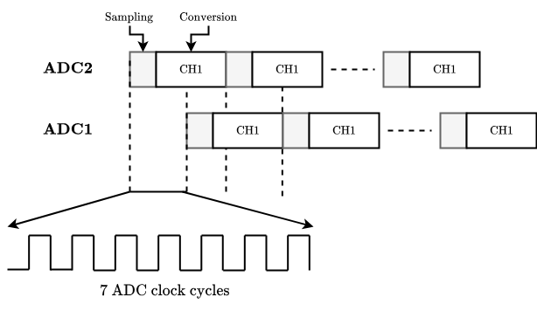
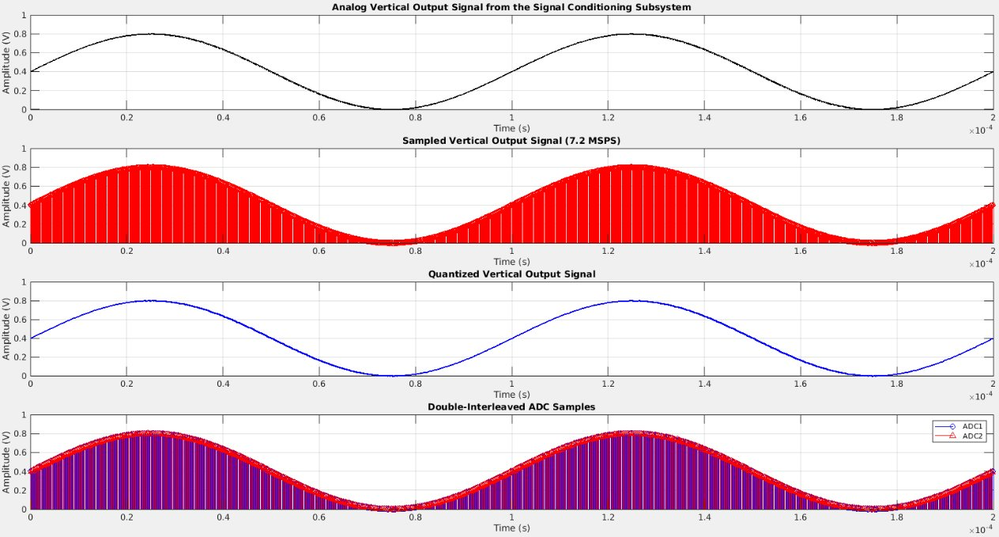
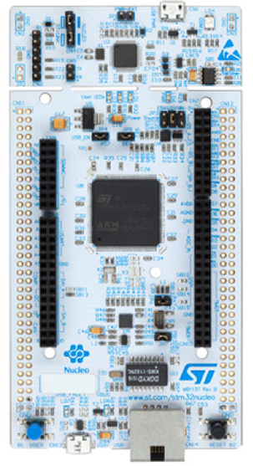
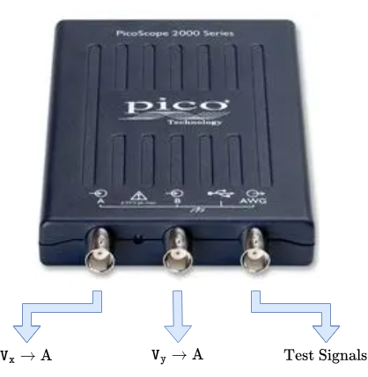
Methodology
28 May 2025
Data Acquisition Subsystem (DAS) Design
Objective: Digitize conditioned signals with 801 points per scan.
Design:
Use two 16-bit ADCs in double-interleaved mode (7 MSPS total) on STM32H723ZG.
Sample vertical (0-300 kHz), horizontal, and pen-lift outputs via DMA2/DMA1.
Alternative: Picoscope 2204A (100 MSPS) for backup sampling.
Implementation: Embedded C with HAL library, buffer size 802, stored as .csv files.
Figure 9.1: Illustrating ADC1 and ADC2 operation in double interleaved mode
Figure 9.2: MATLAB-simulated outputs of STM32H723ZG double interleaved mode.
Figure 9.3: STM32H723ZG microcontroller.
Figure 9.4: Alternative sampling device.
Digitizing and Moderning a HP141-display
9

Slide 11
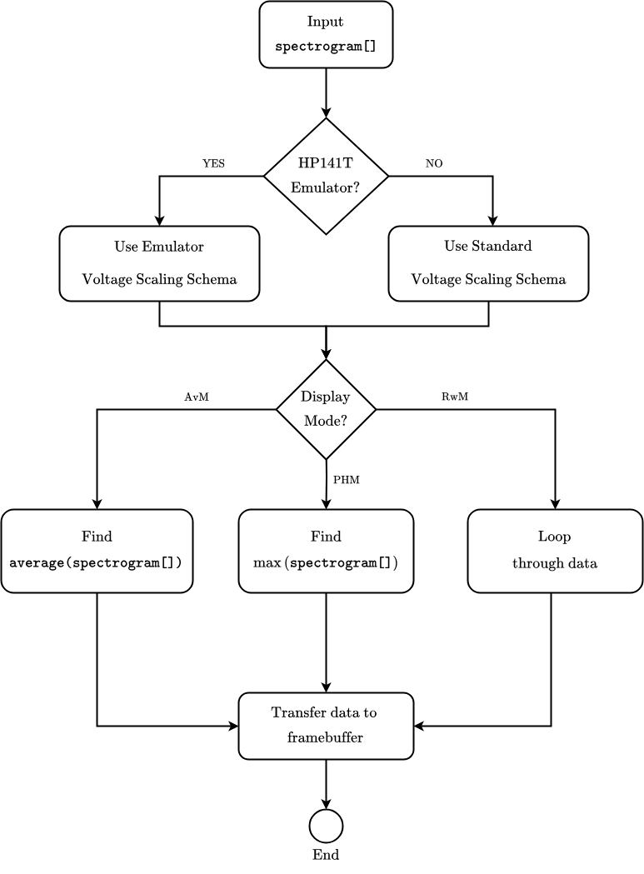
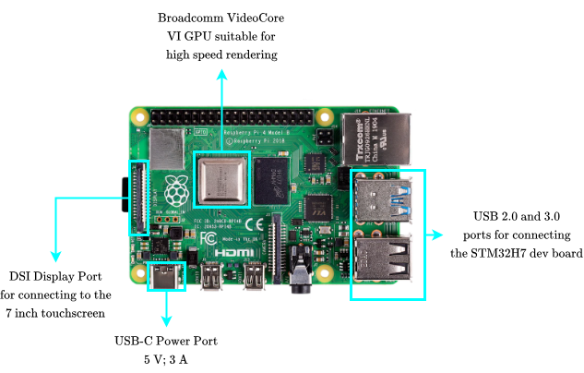
Methodology
28 May 2025
Digital Processing Subsystem (DPS) Design
Purpose: Process digitized data for display modes (PHM, AVM, RWM).
Design:
Use Raspberry Pi 4B (1.5 GHz Cortex-A72) for real-time processing.
Apply scaling (e.g., 0-3.3 V → 0 to -80 dB) and interpolation (linear/Spline).
Functions: max() for PHM, average_spectrogram() for AVM, raw data for RWM.
Pipeline: Process .csv data from DAS, output to GUI.
Figure 10.1: Single-board computer for processing and display control.
Figure 10.2: Flow diagram of Python-based digital processing.
10
Digitizing and Moderning a HP141-display

Slide 12
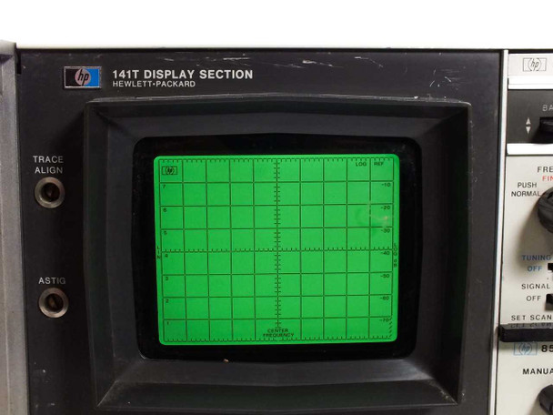
Methodology
28 May 2025
Graphical User Interface Subsystem (GUIS) Design
Goal: Render amplitude vs frequency on LCD touchscreen.
Design:
Use matplotlib and tkinter on Raspberry Pi framebuffer (/dev/fb0).
7-inch TFT DSI touchscreen (800x480), 8x10 grid, black/green/grey aesthetic.
Modes (PHM, AVM, RWM) via touch buttons, with help popup (400x300 px).
Features: Trace storage, Nielsen’s heuristics (e.g., visibility, error prevention).
Figure 11: Amplitude vs frequency display must resemble the HP141T Display Section.
11
Digitizing and Moderning a HP141-display

Slide 13

Methodology
28 May 2025
Experimental Test Procedures
Real-time performance assessment
Setup:
Use Siglent SDG1010, HP-E3630A, Picoscope 2204A, and probes.
Connect to Linux Dell Inspiron 15 with Picoscope 7 software.
Tests:
Unit Tests: Verify subsystems (e.g., UTA00-UTA03 for HP141T, UTD00-UTD05 for DAS).
Integration Tests: Validate subsystem interfaces (e.g., SCS to DAS data flow).
Acceptance Tests: Confirm compliance with UR01-UR10, SR01-SR06.
Metrics: Voltage range, sampling rate, display mode accuracy.
Unit tests
Integration test
Acceptance test
12
Digitizing and Moderning a HP141-display

Slide 14
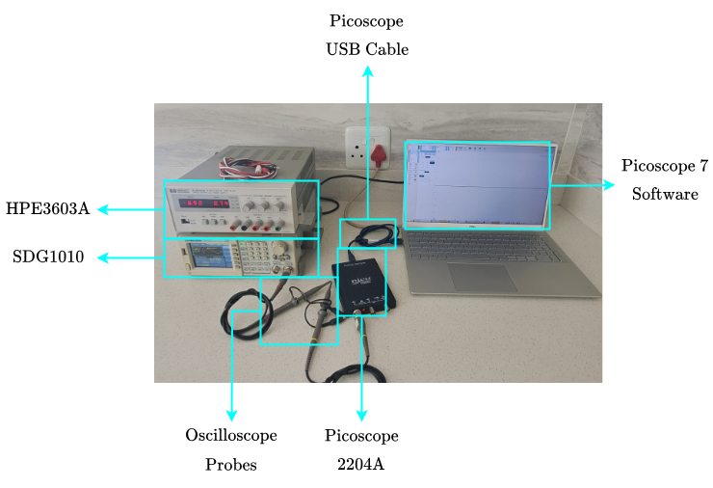
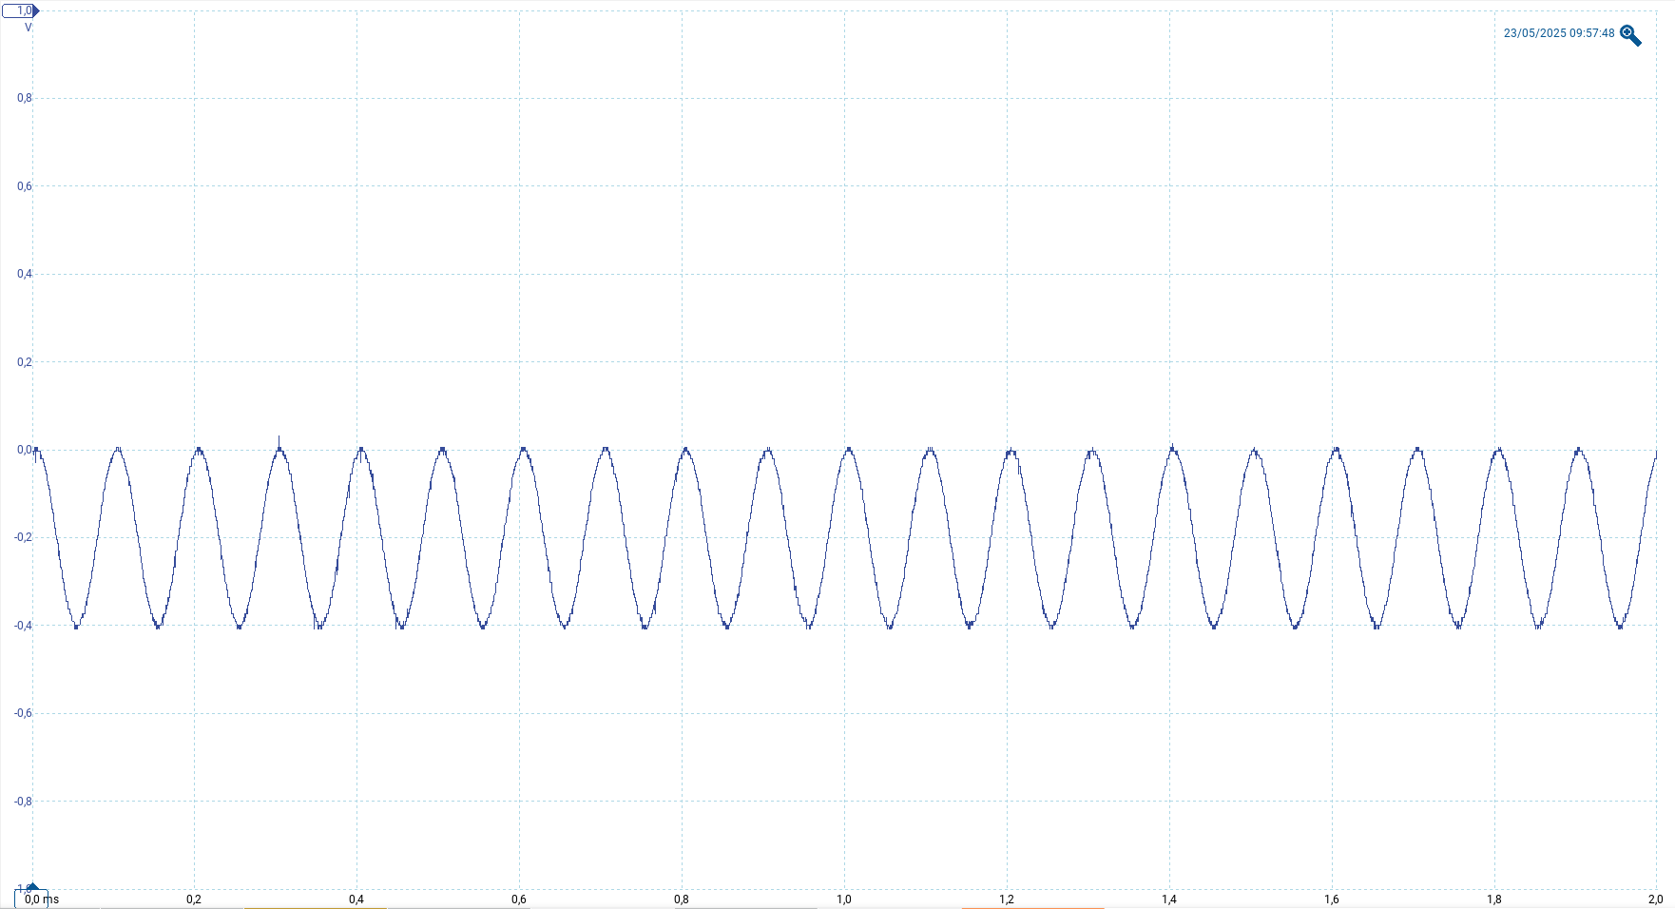
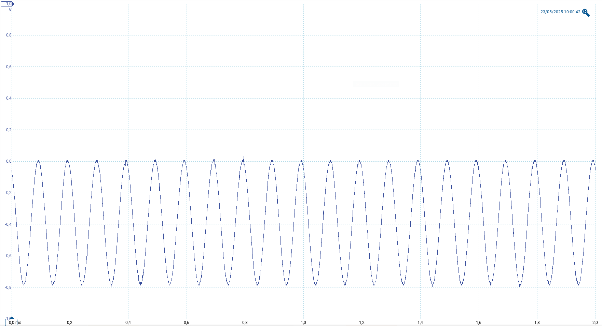
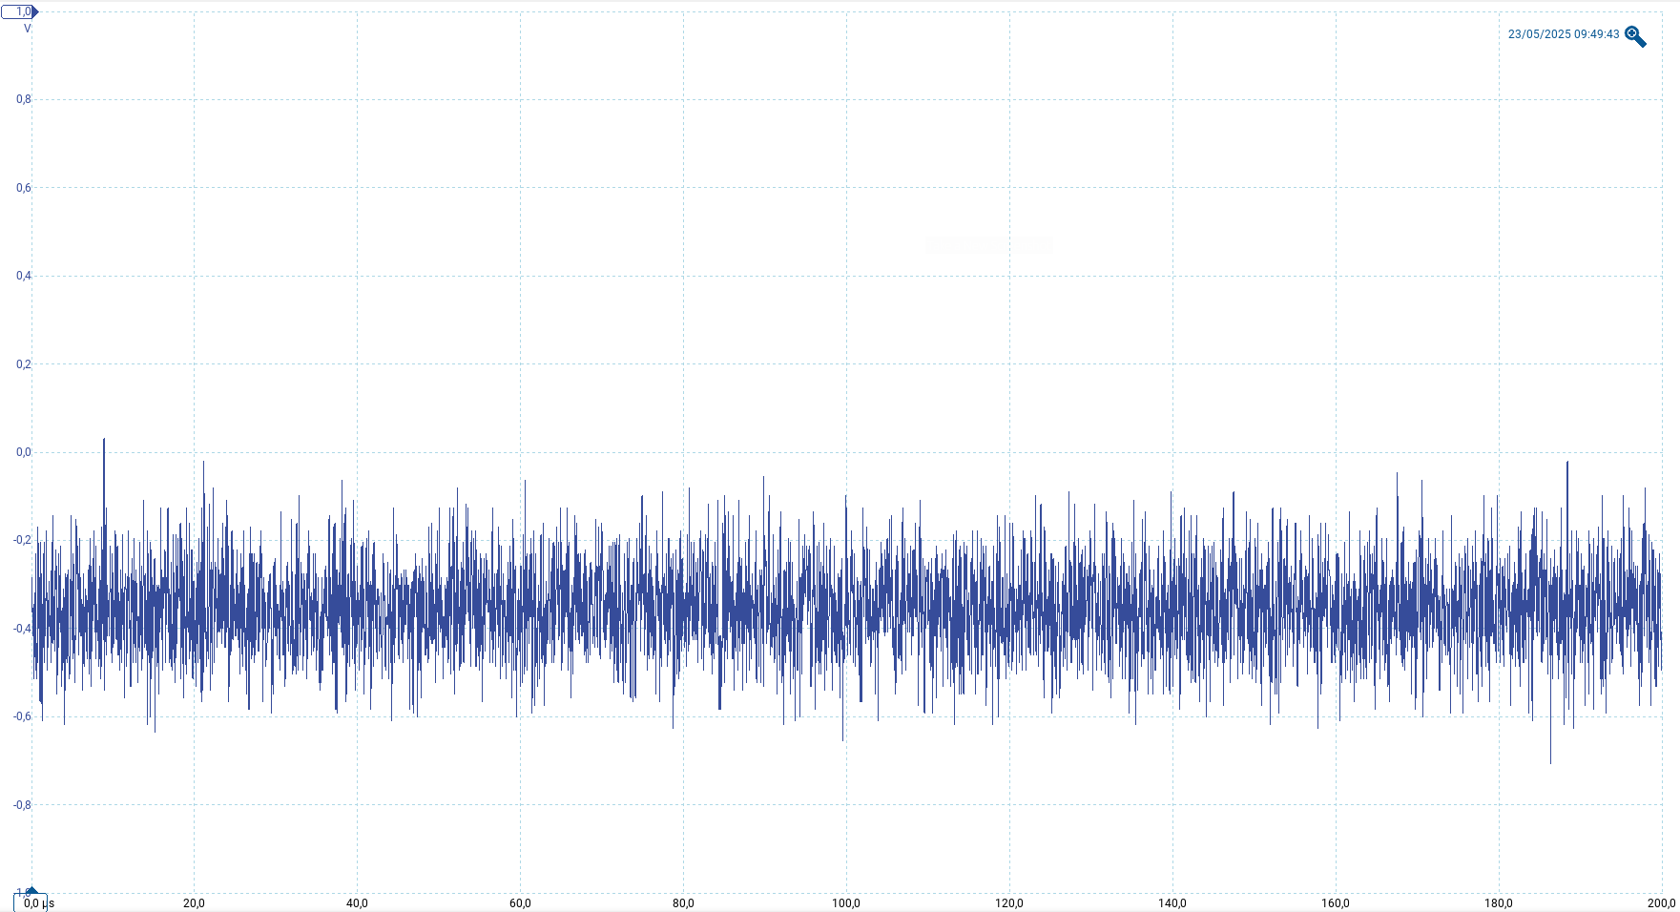
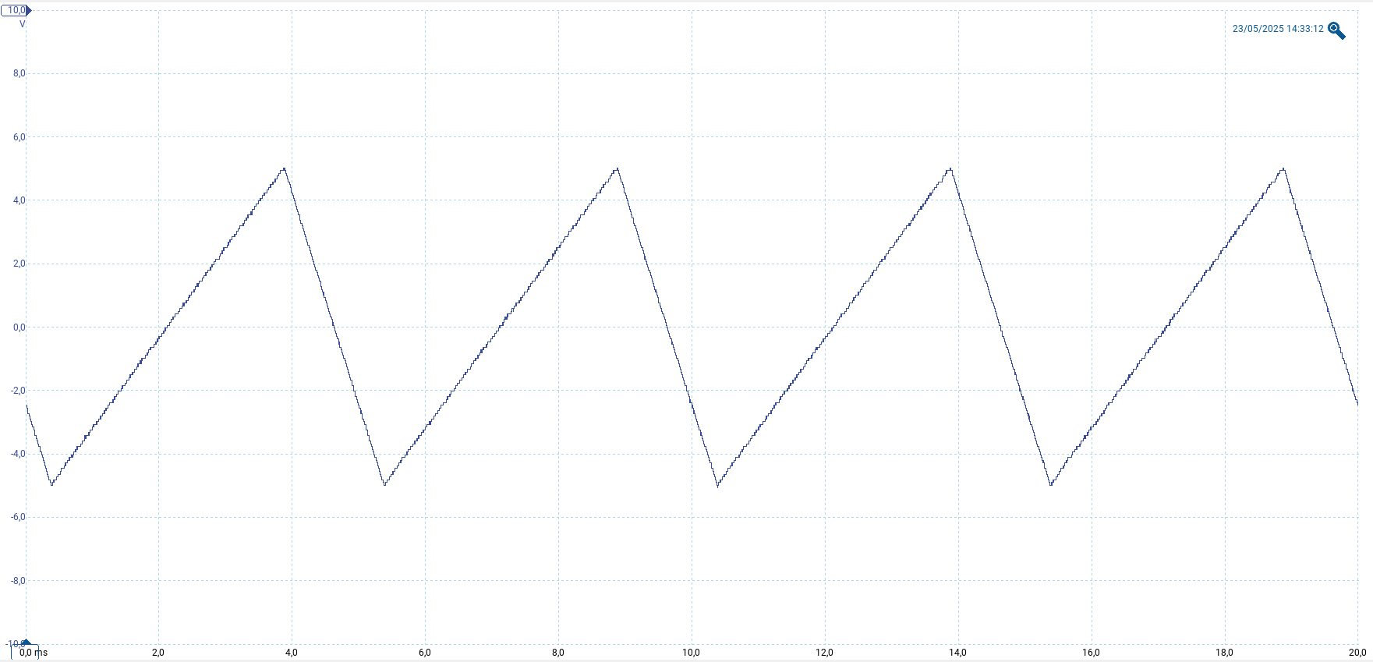
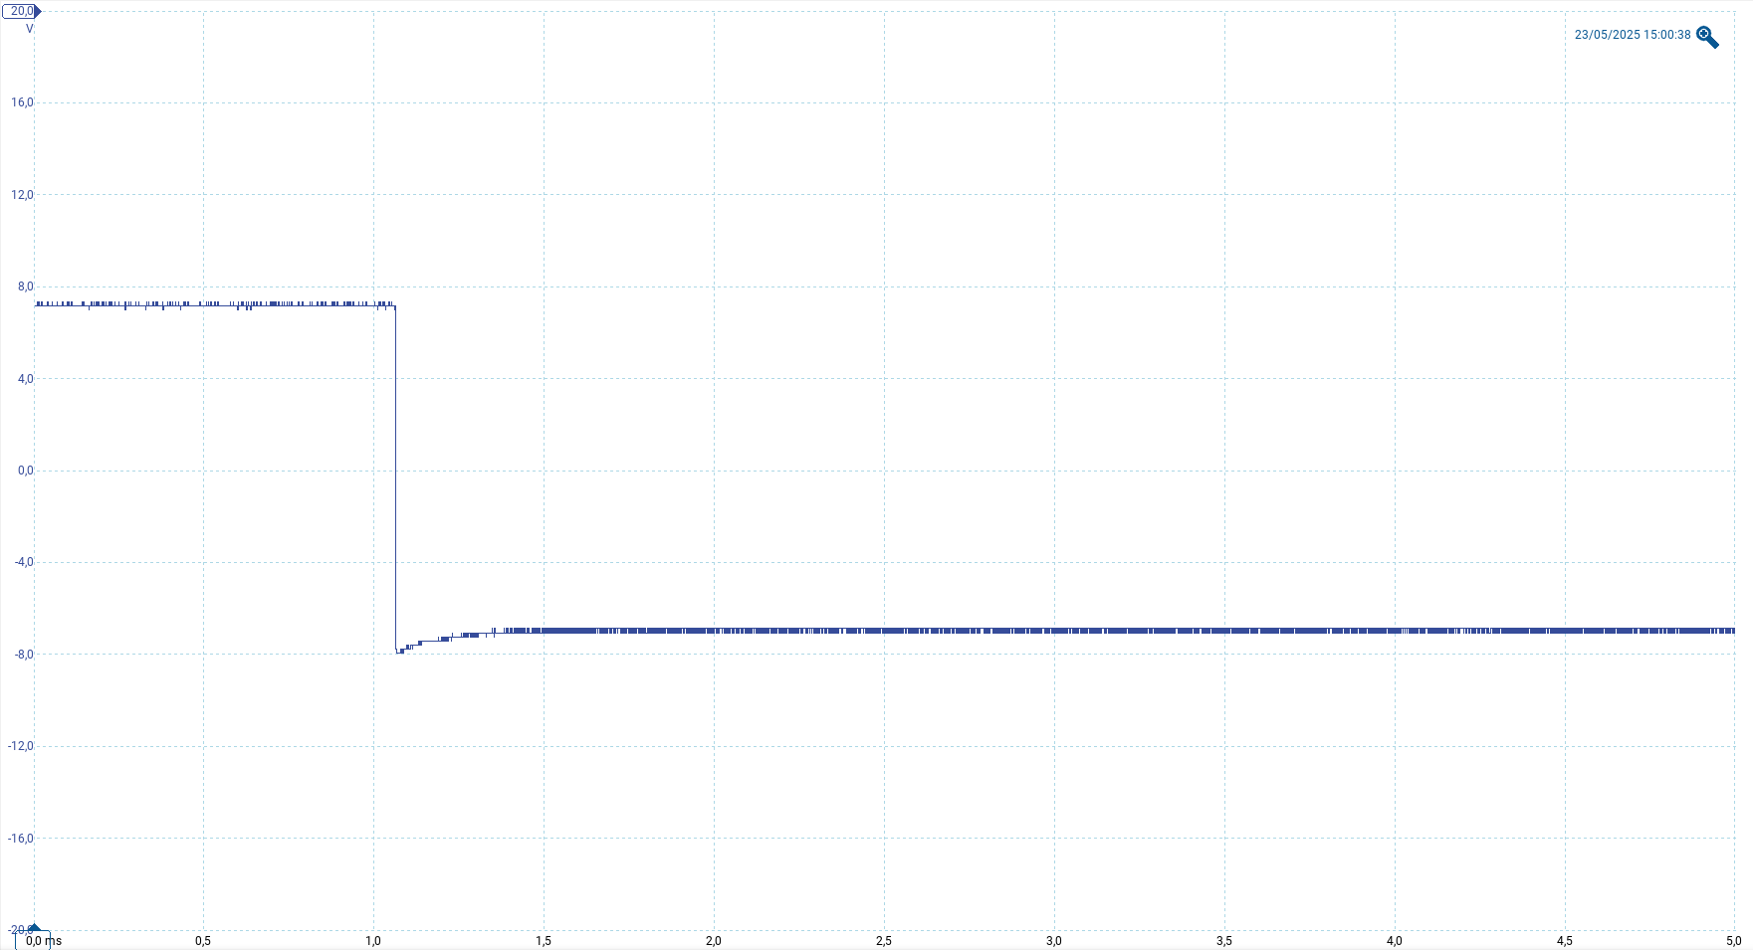
Results and Discussion
28 May 2025
HP141T System Test Results
Calibration Frequency = 10 kHz
Vertical Output:
SDG1010 generated sinusoidal wave: 0 V to -0.2 V at 10 kHz, measured 202 mVpp (set 180 mVpp, 2.5% error).
Range 0 V to -0.8 V: Accuracy decreased (2.1% to 4.6%), noise higher at smaller ranges.
Noisy Signal : Gaussian noise (σ = 136.2 mV, mean -360 mV) approximated 300 kHz fluctuations.
Horizontal Output: SDG1010 ramp (-5 V to 5 V) mismatched HP141T sawtooth shape, limited timing accuracy.
Pen-Lift Output: SDG1010 capped at ±7 V, failed to reach 0 V to 14 V.
0 V
-0.4 V
-0.8 V
Figure 13.1: Experimental Setup
Figure 13.2: Vertical output tested at different levels up to –0.8 V
+5 V
Vpenlift = 7 V
-5 V
Figure 13.3: Noisy signal approximates fluctuations.
Figure 13.4: Horizontal output shape approximated by a triangular wave function
Figure 13.5: Pen-lift output set to 7V.
13
Digitizing and Moderning a HP141-display

Slide 15
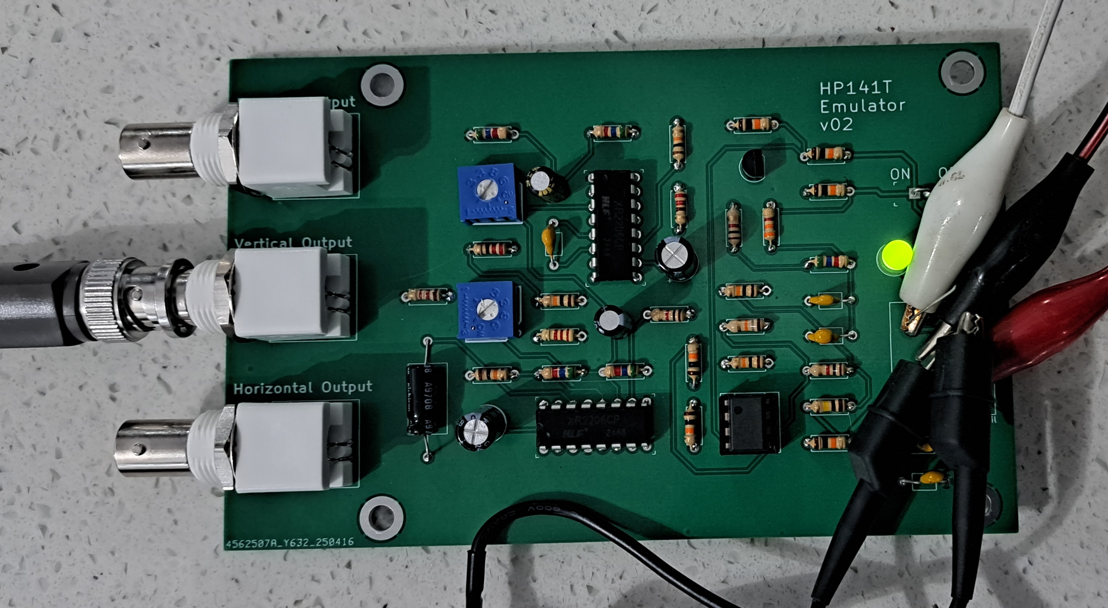
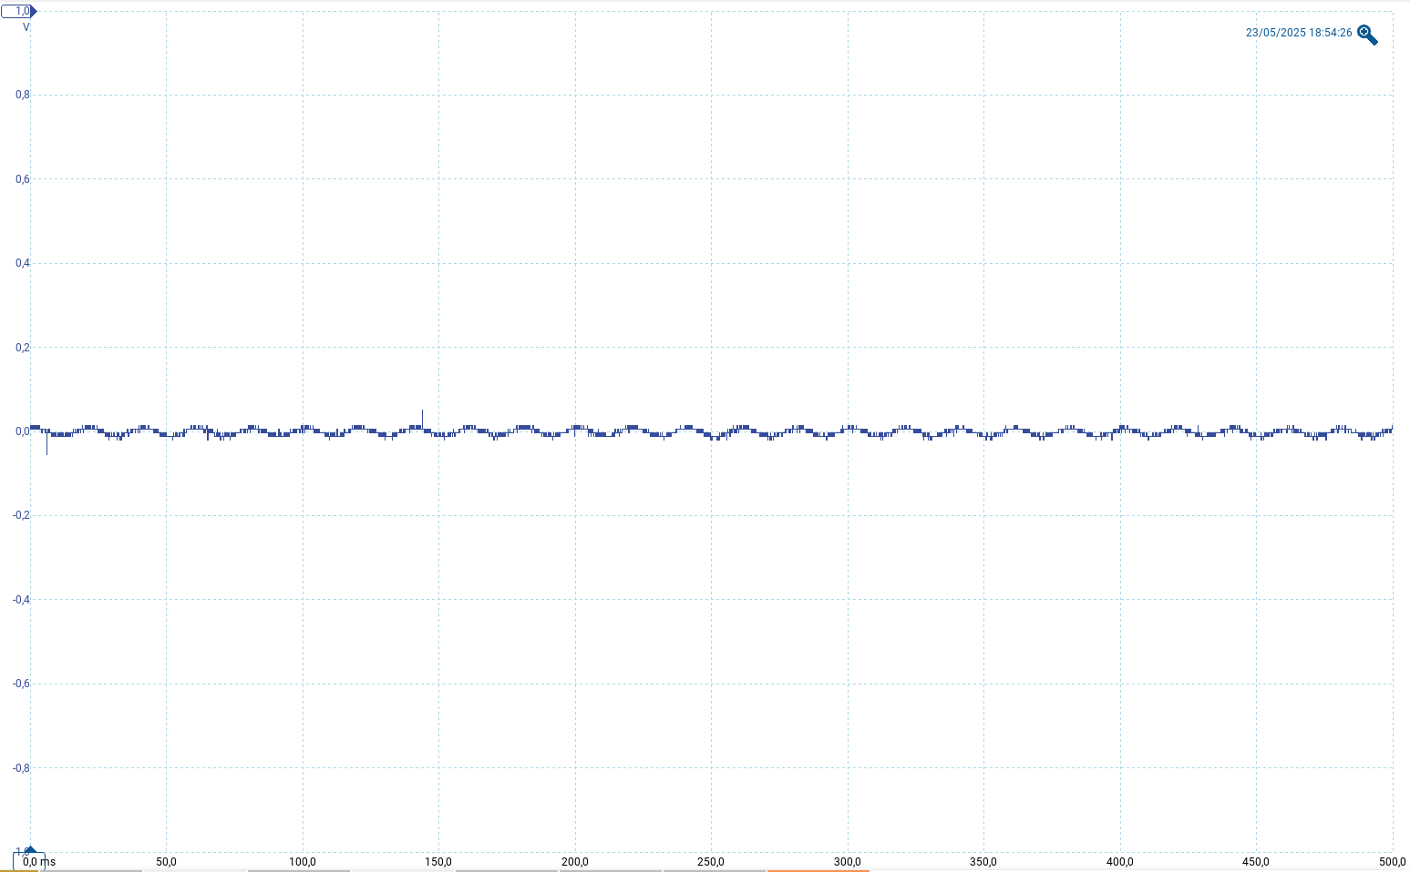
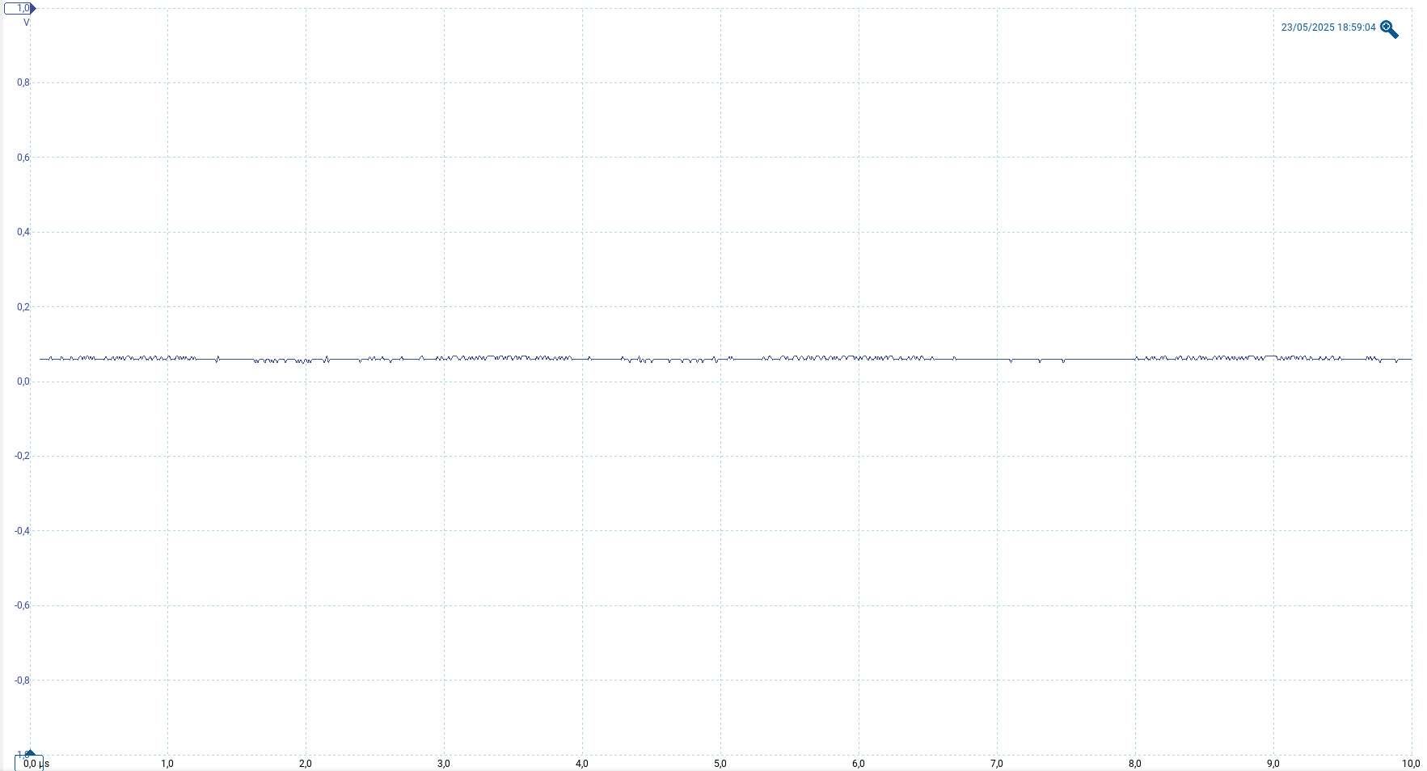
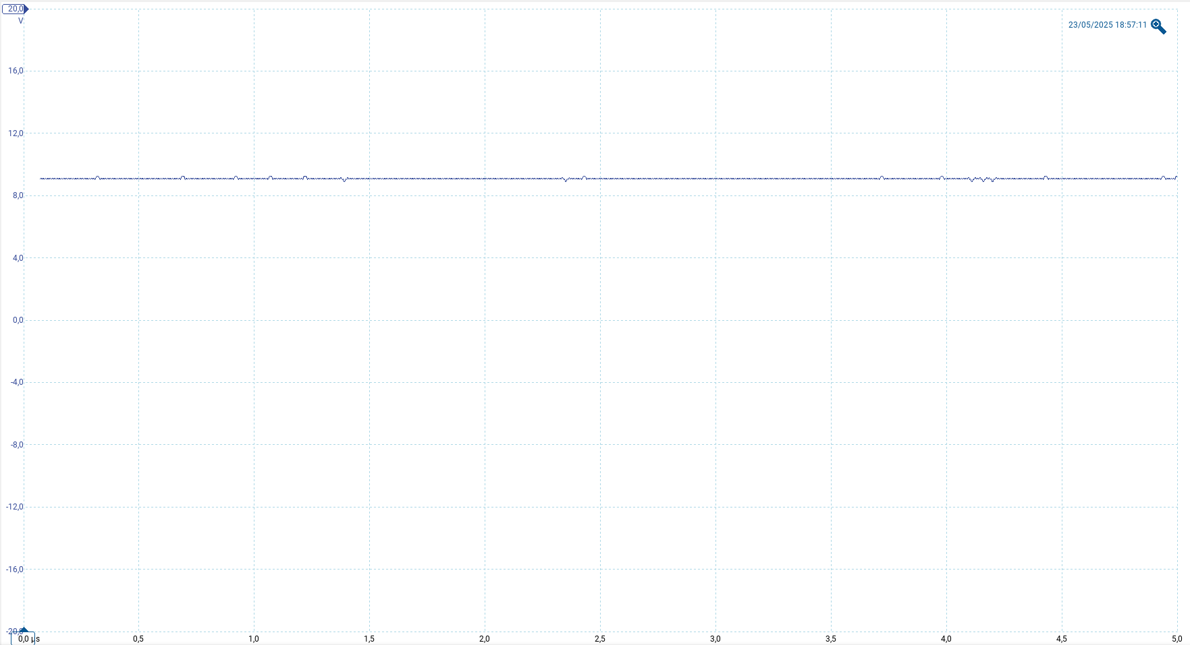
Results and Discussion
28 May 2025
HP141T Emulator Test Results
Hardware: Built with E6 resistors/capacitors, deviating from E24 series design.
Outputs:
Vertical (UTB00): Failed, did not range 0 V to 3.0 V.
Horizontal (UTB02): Failed, no sawtooth (-4.76 V to 4.75 V).
Pen-Lift (UTB03): Failed, no toggling (0 V to 14 V).
Power (UTB04): Passed, rails stable at +5 V (±0.1 V), ±12 V (±0.2 V).
Observation: Component mismatches caused failures; redesign needed.
Figure 14.1: HP141T Emulator.
Figure 14.2: Emulator Vy.
Figure 14.3: Emulator Vx.
Figure 14.4: Emulator Vpenlift.
14
Digitizing and Moderning a HP141-display

Slide 16
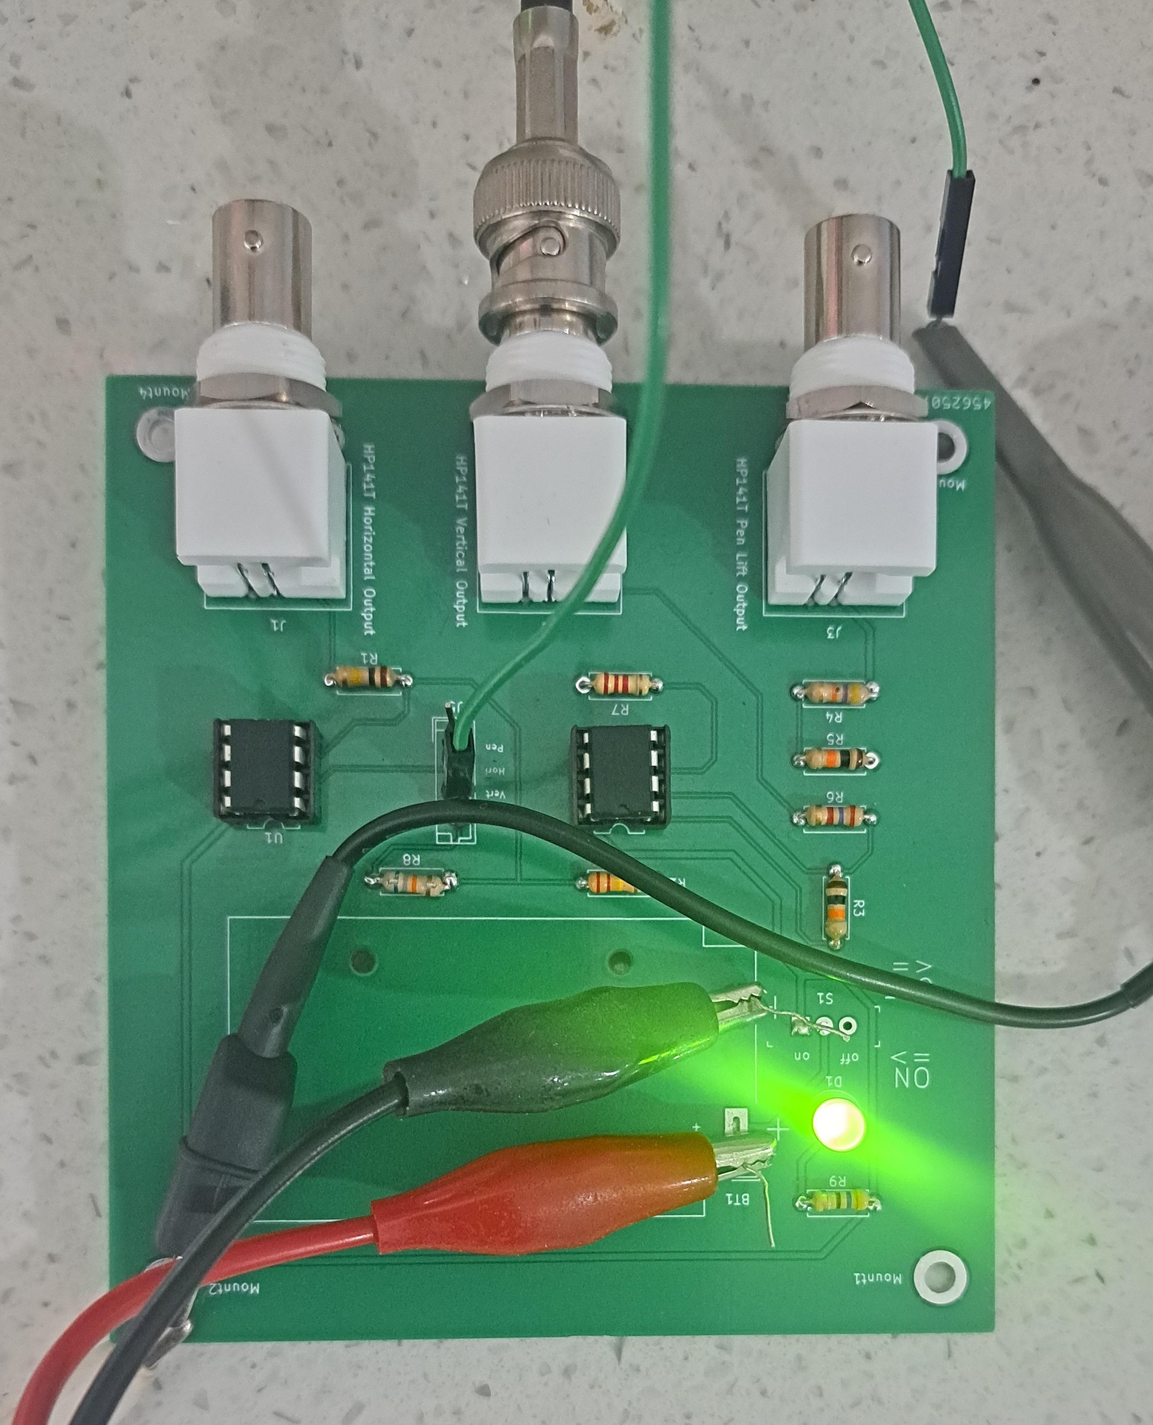
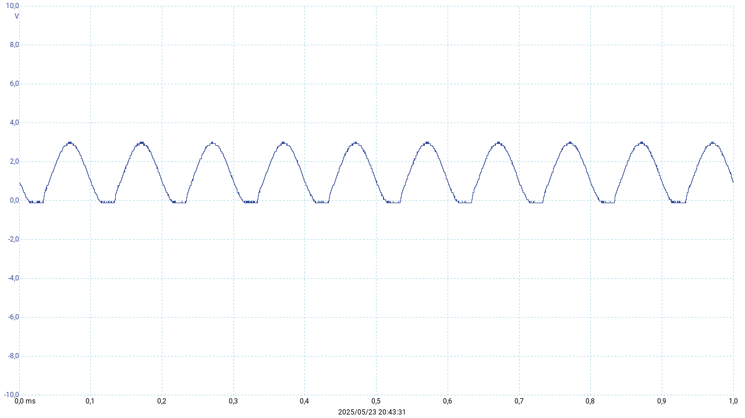
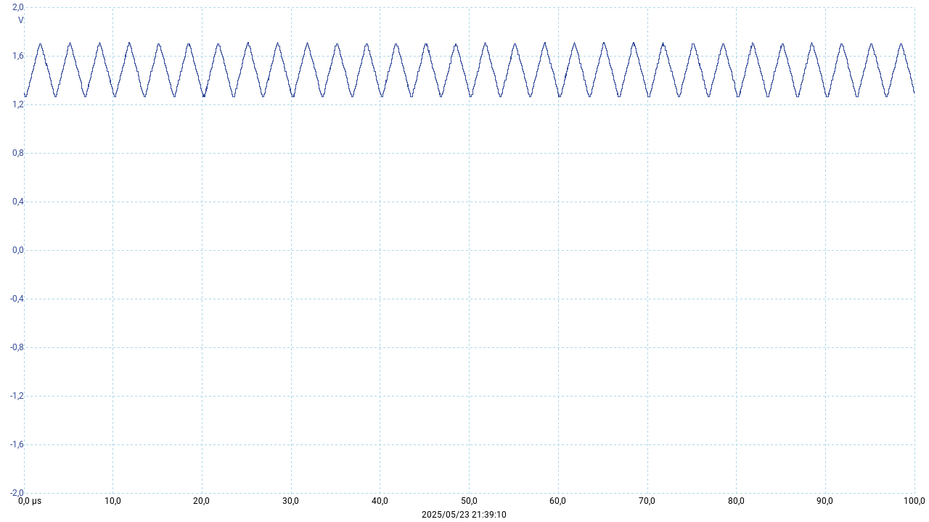
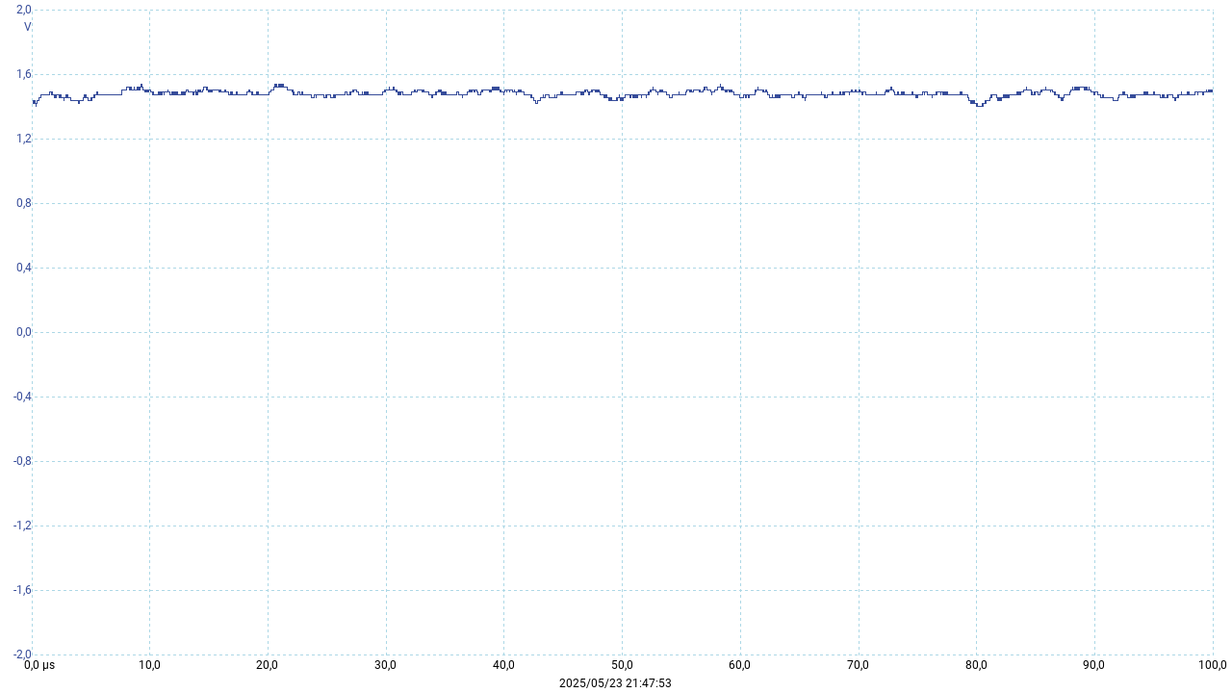
Results and Discussion
28 May 2025
Signal Conditioning Subsystem (SCS)
Vertical Scaling:
-0.2 Vpp input scaled to 0.7 V, within 0 V to 3.3 V (UTC01 passed).
Clipping evident at -0.8 Vpp, reduced at higher frequencies.
Horizontal Scaling (UTC02):
±5 V to 0 V–3.3 V,
waveform preserved.
Pen-Lift (UTC03):
Toggled 0 V to 3.3 V as expected.
Noise (UTC04):
< 20 mV, no distortion; overvoltage protection confirmed (UTC05).
Noisy Input:
Handled Gaussian noise (σ = 136.2 mV), output within 0 V to 3.3 V.
Figure 15.1: SCS Circuit Board.
Figure 15.2: Voltage clipping at higher voltage.
Figure 15.3: Distortion at higher frequencies.
Figure 15.4: Blocks higher frequency components in noisy signals.
15
Digitizing and Moderning a HP141-display

Slide 17
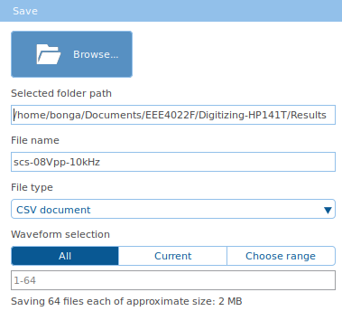
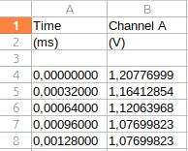
Results and Discussion
28 May 2025
DAS Test Results
Setup: Used Picoscope 2204A due to STM32H723ZG unavailability, impacting real-time performance.
Samplin:
Captured 6257 points at 3.3 kHz (0.0003 s intervals), exceeding 801 points/scan requirement.
Stored in .csv with columns: Time (ms), Vx (V), Vy (V), Vz (V).
Code: spectrogram_to_csv() formatted 801-point blocks.
Observation: Picoscope sufficient for testing, but STM32H723ZG needed for 7.2 MSPS target.
Figure 16.1: Picoscope implemented as sampling device.
Figure 16.2: Time spent saving csv files reduces real-time performance.
Figure 16.3: Sampled SCS vertical output data.
16
Digitizing and Moderning a HP141-display

Slide 18
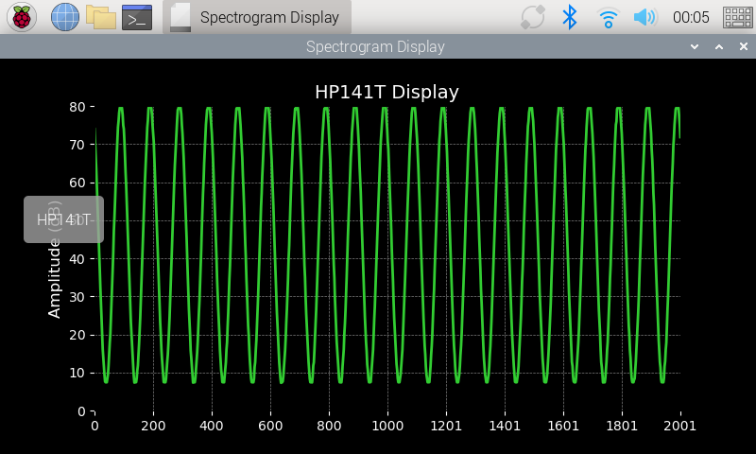
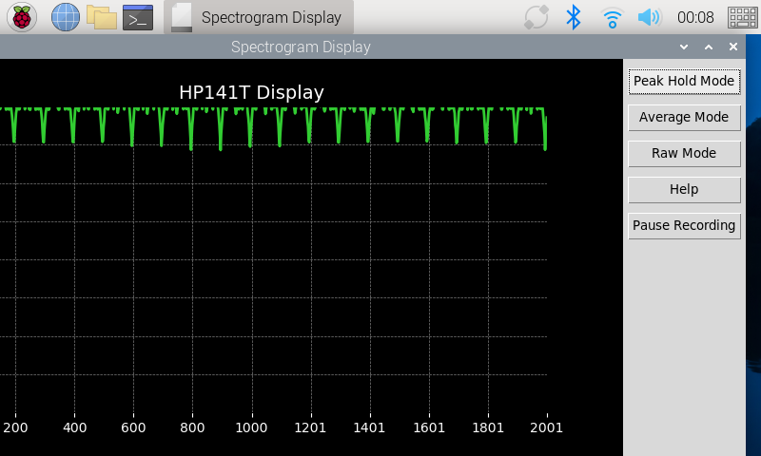
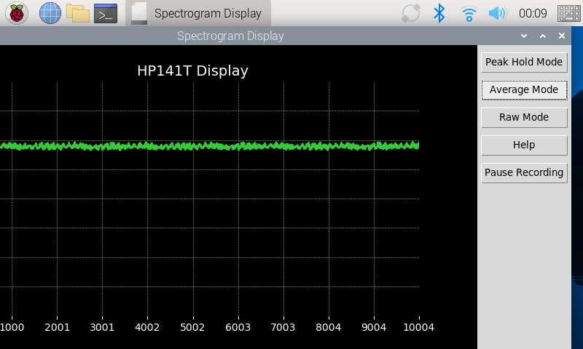
Results and Discussion
28 May 2025
DPS and GUIS Test Results
DPS:
Scaling (UTE00): Voltage to dB conversion passed (80 × (3.3 - Vy)/3.3).
PHM (UTE01), AVM (UTE02), Interpolation (UTE03): All passed, smooth output via CubicSpline.
GUIS:
Display (UTF00): 10 dB/division accurate.
Responsiveness (UTF02): Updates in 50–100 ms.
Modes (UTF01): PHM, AVM, RWM switching seamless.
Help Feature:
Tutorial popup functional.
Figure 17.1 (a): Vx Input = -320 mV, 10 kHz.
Figure 17.2 (a): Noise with stdev = 132 mV, µ = -200 mV.
Figure 17.1 (b): Peak Hold Mode (PHM).
Figure 17.4 (b): Average Mode (AVM).
17
Digitizing and Moderning a HP141-display

Slide 19
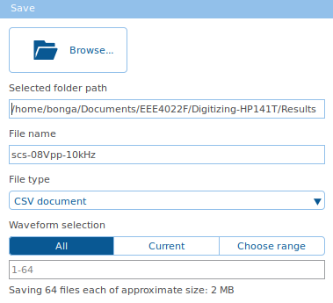
Results and Discussion
28 May 2025
Overall System Results
3. Save data in Picoscope 7.
Integration: Picoscope-based DAS fed SCS outputs to DPS/GUIS on Raspberry Pi 4B.
Performance:
Displayed 10 MHz to 18 GHz spectrum, 6257 points/scan.
Modes (PHM, AVM, RWM) and trace storage operational.
Limitations: Horizontal/pen-lift emulation issues persisted; Picoscope limited real-time sampling.
Acceptance: Partially met UR01-UR10, SR01-SR06; requires emulator fixes.
Next Steps: Integrate STM32H723ZG, refine emulator design.
Generate HP141T outputs.
2. Condition signals.
5. Display spectrogram.
4. Process data.
Figure 18: Steps in full system operation.
18
Digitizing and Moderning a HP141-display

Slide 20

Conclusion
28 May 2025
Conclusion
Achievements: Vertical output approximated with ~10% deviation using SDG1010/Picoscope; SCS scaled -0.8 V to 3.3 V effectively; DPS/GUIS on Raspberry Pi 4B met all tests (50-100 ms latency, PHM/AVM/RWM modes).
Challenges: Emulator failed due to E6 vs. E24 component mismatch; horizontal/pen-lift emulation inaccurate; DAS limited by Picoscope (3.3 kHz vs. 7.2 MSPS).
Significance: Demonstrates partial success in digitizing HP141T, with robust software and signal conditioning, but hardware emulation needs work.
Status: System functional but incomplete; further testing required with the STM32H723ZG.
19
Digitizing and Moderning a HP141-display

Slide 21

Recommendations
28 May 2025
Recommendations
HP141T System Tests: Perform tests with the actual HP141T to validate SDG1010 approximations.
HP141T Emulator: Use E24 resistors, test XR2206 chips on breadboard, adopt 5-pole DIN 41524 socket.
SCS: Upgrade to NE5532, TL072, or TLV324 op-amps for better accuracy.
DAS: Procure STM32H723ZG early; add capacitor near ADC pins on STM32H746ZG for settling time.
DPS: Implement FPGA for higher performance.
GUIS: Develop touchscreen matching original CRT dimensions.
20
Digitizing and Moderning a HP141-display

Slide 22

Thank You!
28 May 2025
Digitizing and Modernizing an HP141-display
Github Repo
21
Digitizing and Moderning a HP141-display

